Slide 1



INSTITUTE : UIE
DEPARTMENT : CSE
Bachelor of Engineering (Computer Science & Engineering)
Disruptive Technologies-3
(23CSH-203)
Topic: Blockchain
DISCOVER . LEARN . EMPOWER
Notes:
1

Slide 2
Blockchain

Slide 3
Components of Blockchain Network
Components of Blockchain Network As per the name ‘Blockchain‘, it itself suggests that information (i.e transactions) will be stored in the form of blocks. Every node can see the block, but they can’t tamper with them. If a block value is tampered the hash value associated with that block changes and that block will be disconnected from the network. On an average of 12.6 seconds, every node in the blockchain network gets the most updated blockchain. The technology behind Bitcoins is the Blockchain Network. Following are the components of a Blockchain network –
Node
Ledger
Wallet
Nonce
Hash

Slide 4
Components of Blockchain Network
1. Node – It is of two types – Full Node and Partial Node.
Full Node – It maintains a full copy of all the transactions. It has the capacity to validate, accept and reject the transactions.
Partial Node – It is also called a Lightweight Node because it doesn’t maintain the whole copy of the blockchain ledger. It maintains only the hash value of the transaction. The whole transaction is accessed using this hash value only. These nodes have low storage and low computational power.
2. Ledger – It is a digital database of information. Here, we have used the term ‘digital’ because the currency exchanged between different nodes is digital i.e cryptocurrency. There are three types of ledger. They are –
Public Ledger – It is open and transparent to all. Anyone in the blockchain network can read or write something.
Distributed Ledger – In this ledger, all nodes have a local copy of the database. Here, a group of nodes collectively execute the job i.e verify transactions, add blocks in the blockchain.
Decentralized Ledger – In this ledger, no one node or group of nodes has a central control. Every node participates in the execution of the job.
11

Slide 5
Components of Blockchain Network
3. Wallet – It is a digital wallet that allows user to store their cryptocurrency. Every node in the blockchain network has a Wallet. Privacy of a wallet in a blockchain network is maintained using public and private key pairs. In a wallet, there is no need for currency conversion as the currency in the wallet is universally acceptable. Cryptocurrency wallets are mainly of two types –
Hot Wallet – These wallets are used for online day-to-day transactions connected to the internet. Hackers can attack this wallet as it is connected to the internet. Hot wallets are further classified into two types – a. Online/ Web wallets – These wallets run on the cloud platform. Examples – MyEther Wallet, MetaMask Wallet. b. Software wallets – It consists of desktop wallets and mobile wallets. Desktop wallets can be downloaded on a desktop and the user has full control of the wallet. An example of a desktop wallet is Electrum. c. Mobile wallets – They are designed to operate on smartphone devices. Example – mycelium.

Slide 6
Components of Blockchain Network
Cold Wallet – These wallets are not connected to the internet. It is very safe and hackers cannot attack it. These wallets are purchased by the user. Example – Paper wallet, hardware wallet. a. Paper wallet – They are offline wallets in which a piece of paper is used that contains the crypto address. The private key is printed in QR code format. QR code is scanned for cryptocurrency transactions. b. Hardware wallet – It is a physical electronic device that uses a random number generator that is associated with the wallet.
The focus of wallets is on these three things –
Privacy
Transactions should be secure
Easy to use
Privacy of a wallet is maintained using public and private key pairs. Transactions are made secure as a private key is used both to send fund and to open the encrypted message.

Slide 7
Components of Blockchain Network
4. Nonce – A nonce is an abbreviation for “number only used once,” which is a number added to a hashed or encrypted block in a blockchain. It is the 32-bit number generated randomly only one time that assists to create a new block or validate a transaction. It is used to make the transaction more secure.
It is hard to select the number which can be used as the nonce. It requires a vital amount of trial-and-error. First, a miner guesses a nonce. Then, it appends the guessed nonce to the hash of the current header. After that, it rehashes the value and compares this to the target hash. Now it checks that whether the resulting hash value meets the requirements or not. If all the conditions are met, it means that the miner has created an answer and is granted the block.
5. Hash – The data is mapped to a fixed size using hashing. It plays a very important role in cryptography. In a blockchain network hash value of one transaction is the input of another transaction. Properties of the hash function are as follows –
Collision resistant
Hiding
Puzzle friendliness

Slide 8
How Does the Blockchain Work
A blockchain is a distributed database that stores information electronically in a digital format and is shared among the nodes of a computer network. A typical difference between a blockchain and a database is how data is structured. A blockchain is a shared, immutable ledger as the name suggests structures data into chunks or blocks, and a database structures data into tables. A blockchain is a chain of blocks. Once a block is filled with data and it is chained to the previous blocks. Different types of information can be stored on the blockchain network but the most important is transactions.

Slide 9
How Does a Blockchain Work?
1. Facilitating a transaction: A new transaction enters the blockchain network. All the information that needs to be transmitted is doubly encrypted using public and private keys.
2. Verification of transaction: The transaction is then transmitted to the network of peer-to-peer computers distributed across the world. All the nodes on the network will check for the validity of the transaction like if a sufficient balance is available for carrying out the transaction.
3. Formation of a new block: In a typical blockchain network there are many nodes and many transactions get verified at a time. Once the transaction is verified and declared a legitimate transaction, it will be added to the mempool. All the verified transactions at a particular node form a mempool and such multiple mempools form a block.

Slide 10
How Does a Blockchain Work?
4. Consensus Algorithm: The nodes that form a block will try to add the block to the blockchain network to make it permanent. But if every node is allowed to add blocks in this manner then it will disrupt the working of the blockchain network. To solve this problem, the nodes use a consensus mechanism to ensure that every new block that is added to the Blockchain is the one and only version of the truth that is agreed upon by all the nodes in the Blockchain, and only a valid block is securely attached to the blockchain. The node that is selected to add a block to the blockchain will get a reward and hence we call them “miners”. The consensus algorithm creates a hash code for that block which is required to add the block to the blockchain.
5. Addition of the new block to the blockchain: After the newly created block has got its hash value and is authenticated, now it is ready to be added to the blockchain. In every block, there is a hash value of the previous block and that is how the blocks are cryptographically linked to each other to form a blockchain. A new block gets added to the open end of the blockchain.
6. Transaction complete: As soon as the block is added to the blockchain the transaction is completed and the details of this transaction are permanently stored in the blockchain. Anyone can fetch the details of the transaction and confirm the transaction.

Slide 11
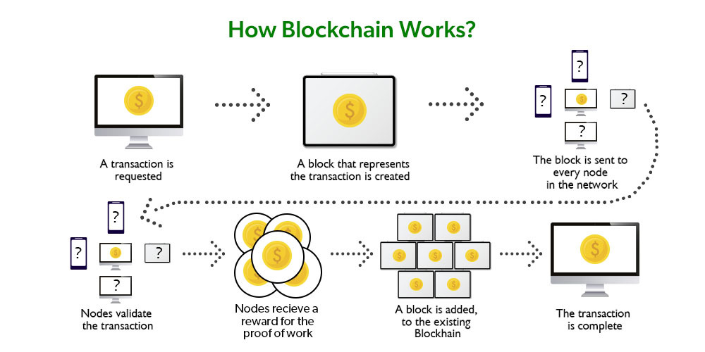
Benefits of Blockchain Technology

Slide 12
Let’s understand this working of blockchain with the help of an example:
Let’s say Jack and Phil are two nodes on the bitcoin blockchain network who wants to carry out a transaction between them.
Step 1: Facilitating the transaction: Jack wants to send 20 BTC to Phil via the Blockchain network.
Step 2: Verification of transaction: The message for verification will be sent to all the nodes on the network. All the nodes will check the important parameters related to the transaction like Does Jack has sufficient balance i.e. at least 20BTC to perform the transaction. Is Jack a registered node? Is Phil a registered node? After checking the parameters the transaction is verified.
Step 3: Formation of a new block: A number of verified transactions stack up in mempools and get stored in a block. This verified transaction will also get stored in a block.

Slide 13
Step 4: Consensus algorithm: Since here we are talking about bitcoins so the Proof-of-Work consensus algorithm will be used for block verification. In proof-of-work, the system assigns the target hash value to a node, and according to this, it must come up with a hash for the new block. The node has to calculate the hash value for the new block that is less than the target value. If two or more miners mine the same block at the same time, the block with more difficulty is selected. The others are known as stale blocks. Mining usually rewards miners with blockchain currency. In this case, the blockchain currency is bitcoin.
Step 5: Addition of the new block in the blockchain: After the newly created block has got the hash value and authentication through proof-of-work only then it will be added to the network and the transaction will mark as complete. Phil will receive 20 BTC from Jack. The new block will be linked to the open end of the blockchain.

Slide 14
Step 6: Transaction complete: As soon as the block is added to the blockchain, the transaction will take place and 20 BTCs will get transferred from Jack’s wallet to Phil’s wallet. The details of the transaction are permanently secured on the blockchain.
Anyone on the network can fetch the information and confirm the transaction. This will help to keep track of all the transactions and to verify whether any user is trying to double spend. For example, if Jack tries to carry out a transaction in the future, the rest of the nodes can check Jack’s past transaction records to check whether Jack has enough balance to carry out the current transaction. If there is enough balance then the transaction will be approved.

Slide 15
Is Blockchain Secure?
In the most basic way, one can think of a blockchain as a linked list. Each of the next items in the list is dependent on the previous item, except for the first block, also known as the genesis block, which is hardcoded into the blockchain. In the blockchain, each block contains the hash of the previous block’s header and a hash of the transactions in the Merkle tree of the current block. In this way, each block is cryptographically chained to the previous block. Let’s understand with an example what happens when someone attempts to change a transaction or block data in a blockchain network.

Slide 16
Suppose, there is a chain of 10 blocks, where the 10th block depends on the 9th block, the 9thblock depends on the 8th block, and so on.
In this way, the 10th block depends on all the previous blocks and the genesis block as well.
If someone tries to change data on the 2nd block, then the attacker will have to change data on all the later blocks as well, otherwise, the blockchain will become invalid since the later blocks depend on the hash value present in the 2nd block and the 2nd block has changed, but not the later blocks.
Thus, as the blocks are added, immutability increases as changing the block is an expensive operation.
Also, to add/change a block in a blockchain, a consensus algorithm is used by nodes in the blockchain network. In order to compensate for the change in one block, one must have to recalculate the hash of every block to update the hash value of the block header in the next block. This will involve a lot of time and computational resources.
In order to succeed with such kind of attack, the hacker has to simultaneously control and change 51% or more copies of the blockchain so that their new copy becomes the majority copy and thus the agreed-upon chain.
Thus, requiring an immense amount of time, money, and computational resources.

Slide 17
References
Text books:
Blockchain Technology: Algorithms and Applications Paperback – 6 December 2023 by Asharaf S.; (Author), Sivadas Neelima (Author), Adarsh S. (Author), Franklin John (Author)
Blockchain Basics: A Non-Technical Introduction in 25 Steps
Book by Daniel Drescher
Websites:
https://ntiprit.gov.in/pdf/blockchainanddistributed/Blockchain_Introduction_KR.pdf
https://bitcoin.org/bitcoin.pdf

Slide 18
THANK YOU

